Slide 1
Lec 07: Technology Lifecycle, Diffusion Patterns and Principles of Innovation
EEE 452: Engineering Economics and Management
M. Rokonuzzaman, PhD
Zaman.rokon.bd@gmail.com
www.the-waves.org
©️Rokonuzzaman
--use is permitted only for the purpose of EEE 452 (sections 1,2,3, 4, & 10 offered at NSU in Spring 2023; no consumption and distribution is allowed for any other purpose

Slide 2
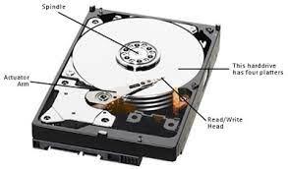
Dynamic Life Cycle of Technology S-Curve
Performance reaching saturation
Although the effect of technologies is revolutionary in nature, they do not all of a sudden show up as a powerful force of economic value creation. Instead they show up in embryonic form. Like living things, they keep growing. For their growth, we need ingredients—continuous flow of ideas.
Like living things, each of the technologies is not equally amenable to progression. Furthermore, sometimes, they get stuck, stop growing—followed by resumption of growth.
However, in general, technologies are born in embryonic form. They keep growing out of the flow of ideas. As they keep growing, their performances keep improving. They keep doing jobs better, often, consuming less resources.
Despite the growth dynamics, invariably, each technology faces the limits of growth. Eventually, slowly, they reach the saturation—stops growing further.
For example, all the great technologies like mighty steam engine, internal combustion engine, transistor, and electronic image sensor emerged in primitive form. They are different phases of maturity. For example, long before, steam engine stopped growing.
Typically, the growth of technology takes the shape of S-Curve. That does not necessarily mean that all technologies follow that. Like living things, their life cycles also show variation.
Typical means of obtaining technology idea are (i) basic research, (ii) generic knowledge, (ii) exploration of curiosity, (iii) applied research, (iv) specific knowledge for mission purposes or breakthrough, (v) development, (vi) proprietary knowledge of novel application systems, or products, (vi) technological enhancement, and (vii) continuous innovation for market value.
Performance of technology
Embryonic emergence
Rapid growth due to the competition of exploiting economic value
Cumulative effects of ideas over time
Performance reaching saturation
Performance Hard Disk technology
Embryonic emergence
Rapid growth
phase
1960 1980 2010

Slide 3
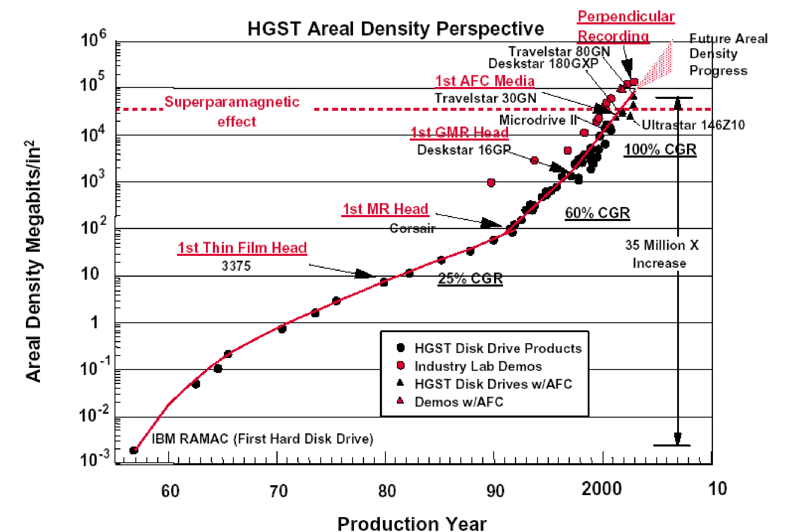
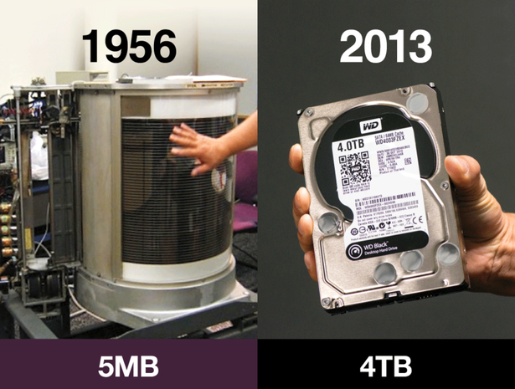
Examples: Disk drive technology for data storage
Magnetic disk drive is a technology for storing and retrieving data with moving head. One of the critical performance parameters of this technology is areal data density. It stands for how many bits could be stored on per square surface area of rotating magnetic disk.
Based on this technology invention, IBM started innovating hard disk drive. The maiden shipment took place in 1957. It was the first 5MB hard disk unit weighing over a ton and was used by the IBM 305 RAMAC. The drive occupied 16 square feet and used fifty 24-inch platters (rotating magnetic disks). Read/write head attached with two independently moving arms used to take an average access time of 600ms.
Due to continued R&D, idea kept flowing in improving areal density-- from 2,000 bits/sq. inch in 1957 (IBM RAMAC) to 1 trillion in 2015 (Toshiba). That is equivalent to growth in areal density at a CAGR of 41%, comparable to that of Moore’s Law for semiconductor devices. Due to this performance growth, disk storage started getting better and also cheaper—leading to deepening the penetration or diffusion.

Slide 4
Phases of Progression and Adoption of Technologies
Like magnetic hard disk drive, many great technologies are born in embryonic form. In their infancy period, the quality is quite low and cost is very high. Civilians do not find them of any use. Invariably, military shows up as initial customers for infant technologies.
As technology keeps growing, customer base keeps expanding from Military to Government agencies, large corporations and mid-sized businesses. Eventually, it reaches the maturity of creating willingness to pay among civilians at profit.
Western countries, led by Germany and USA, used their military agenda to drive technology at the early phase. Due to this reason, many great technologies started witnessing success root in the USA, particularly during post WWII period.
Although this military led initial success plays quite pivotal role in exploiting successive unfolding markets, it is not sufficient. Often, followers take away the lead by higher performance in incremental advancement and reinventions.
For example, IBM led the HDD invention and the exploitation of its innovation fire power. But upon being a late entrant, Toshiba has taken over the computer storage business by reinvention.
By the way, using military agenda for nurturing technologies for exploiting civilian market is highly powerful. So far, the USA has been leading it. However, Russians miserably failed, and China has been attempting to replicate USA’s success.
Civilians
Medium and small enterprises
Performance & Adoption of technology
Large corporations
Government
Military
Cumulative effects of ideas over time
Although, civilian demand offers the largest market, the technology needs to go a long way to create profitable willingness to pay. Managing this progression is highly challenging.

Slide 5
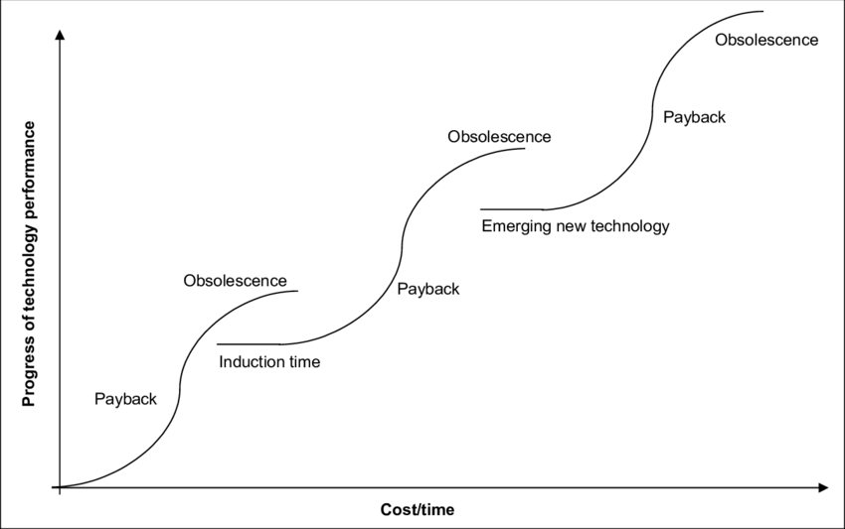
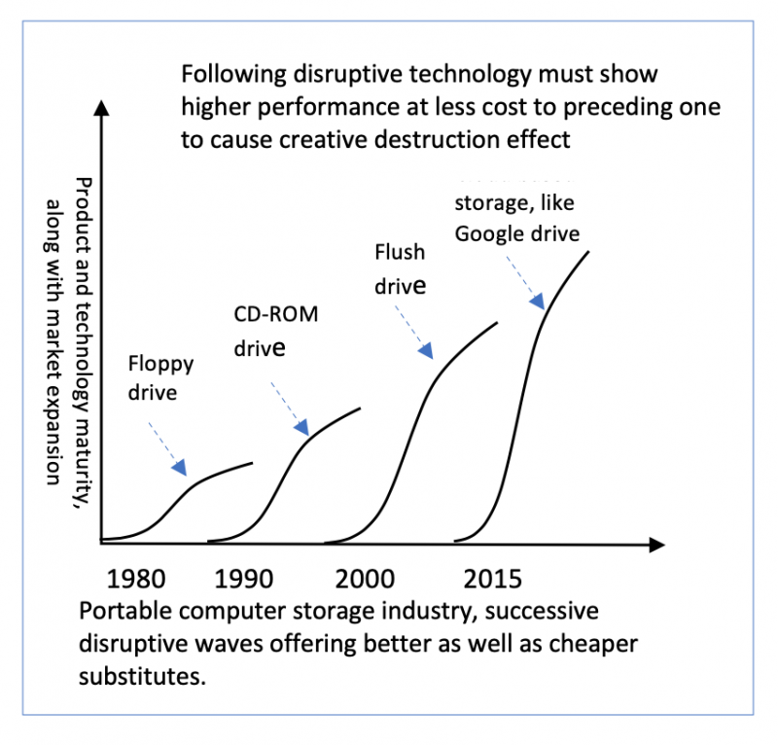
Successive Waves Keep Unfolding—transforming innovations and business
Due to the maturity of current technology core, innovations face barrier to penetrating dipper in the market. One of the ways to to overcome this barrier is to change the technology core.
The change of the technology core leads to another wave of growth. For example, magnetic drum technology was replaced with rotating disk. Subsequently, it has been changed by solid state or electronic data storage technology.
Progressive unfolding of technology core affects innovations, diffusion of technology, and also firms and jobs. Hence, managing this transition is vital.
Technology performance increases with investment, but eventually reaches a plateau where further improvement to performance would either be impossible or prohibitively expensive. Achievement of higher performance requires a discontinuous switching to a different technology core for serving the purpose better at less cost, which in turn follows its own S-curve.
However, the S-curve of the emerging technology may start at a performance level below that of the mature technology, but it would have the potential to overtake its predecessor.
Ref: https://www.the-waves.org/2021/12/05/innovation-diffusion-as-progressive-waves/

Slide 6
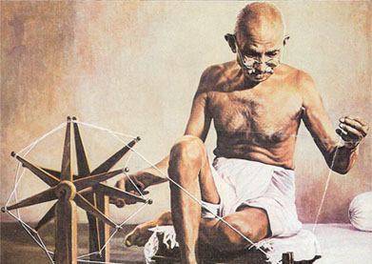

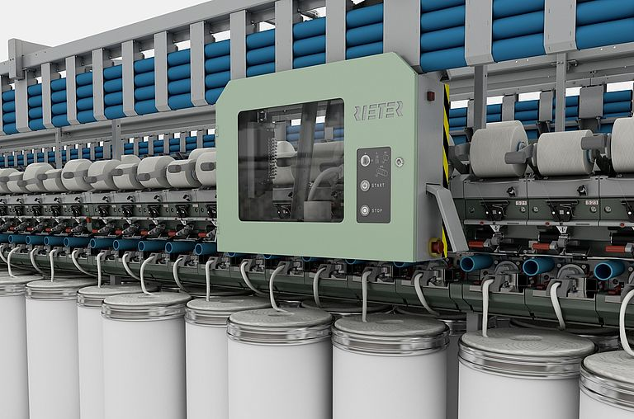
Theorizing innovations Purpose and Process of Technology Inventions—driving innovations in getting jobs done better
Purpose of technology invention is to create a means of bringing innovation, whether as product or process features, to get our jobs done better.
The process of invention and its advancement is to feed urgency and knowledge to our creative process-–an innate ability. Creativity is our by born ability, but it could be sharpened and empowered with tools.
For example, once human beings used to rotate the spinning machine to produce yarn from cotton and other natural fibers. But human beings faced the urgency of improving the quality and reducing the labor requirement. Hence, they invented means of rotating spinning machine with mechanical—followed by electrical--energy. This invention led to bringing innovation into yarn spinning.
Invention, however, emerge in primitive form. Hence, we keep producing ideas in refining them, resulting in better performing innovation in getting our jobs done.
For inventing new technology and its refinement, we need a constant flow of knowledge. Here, knowledge is the ingredient. But knowledge alone is not sufficient. It must be blended with urgency. It happens to be that the profit making incentive is a persistent source of urgency. Hence, profit making competition plays a vital role in producing and transferring knowledge into technology ideas for creating economic value.
However, creating the opportunity of profiting from ideas has been growing. Ideas must be integrated into products and processes to trade them.
Urgency
Ideas for Technology invention and advancement
Knowledge

Slide 7
Scaling up Inventions and Innovations
Scaling refers to growing ability for inventions and innovations to keep diffusing deeper in society—enabling increasing number of people in getting jobs done better.
It requires the technology and innovation to be getting better and also cheaper for creating profitable willingness to pay among a growing number of people.
To keep scaling up, we need consistent flow of knowledge. It happens to be that many of the inventions in the preindustrial age were not scalable. This is due to the the limited supply of knowledge. In those days, our ancestors used to depend on intuitive observation. Furthermore, they used to rely on tinkering for fine tunning technologies, and craftsmanship to apply them as product or process innovation.
Over the last 300 years, however, human race has complemented intuition with systematic scientific investigation. Hence, knowledge generation has increased. On the other hand, engineering has taken over craftsmanship. As result, both technology inventions and innovations have been enjoying higher scale advantage.

Slide 8
Innovation Types
There are many definitions of innovations and their categorization. However, we are interested only about a specific subset.
There are two major types:
Product innovation
Process innovation
a. Process for producing products
b. Process for using products to produce services
Product Innovations are of three types:
Incremental innovation
Sustaining innovation
Disruptive innovation
Product innovation could go through further division: Innovation of i. Goods and ii. Services.

Slide 9
Product and Process Innovations
Products could be both goods and services. We innovate products around invented technology cores. For example, there have been many lighting innovations. But, often, they use only a few lighting technology cores. For example, LED has been a major technology core.
Similarly, using technologies we innovate different services. For example, healthcare service innovation has been benefiting from many technology cores, starting from x-ray to magnetic resonance imaging.
Process innovation focuses on improving processes for both producing and using products. For example, we have been adopting robotics technology core for innovating manufacturing production processes. On the other hand, we have been using digital technologies in innovating the process of how we use automobiles in offering taxi services.
Technology core plays a vital role in both product and process innovations. For example, the change of imaging technology core from film to digital has led to x ray-imaging product innovation. That product innovation has led to innovation in using x-ray machines in capturing, storing, sharing, and visualizing images. On the other hand, there has been a continuous innovation in the process of producing x-ray machines.

Slide 10
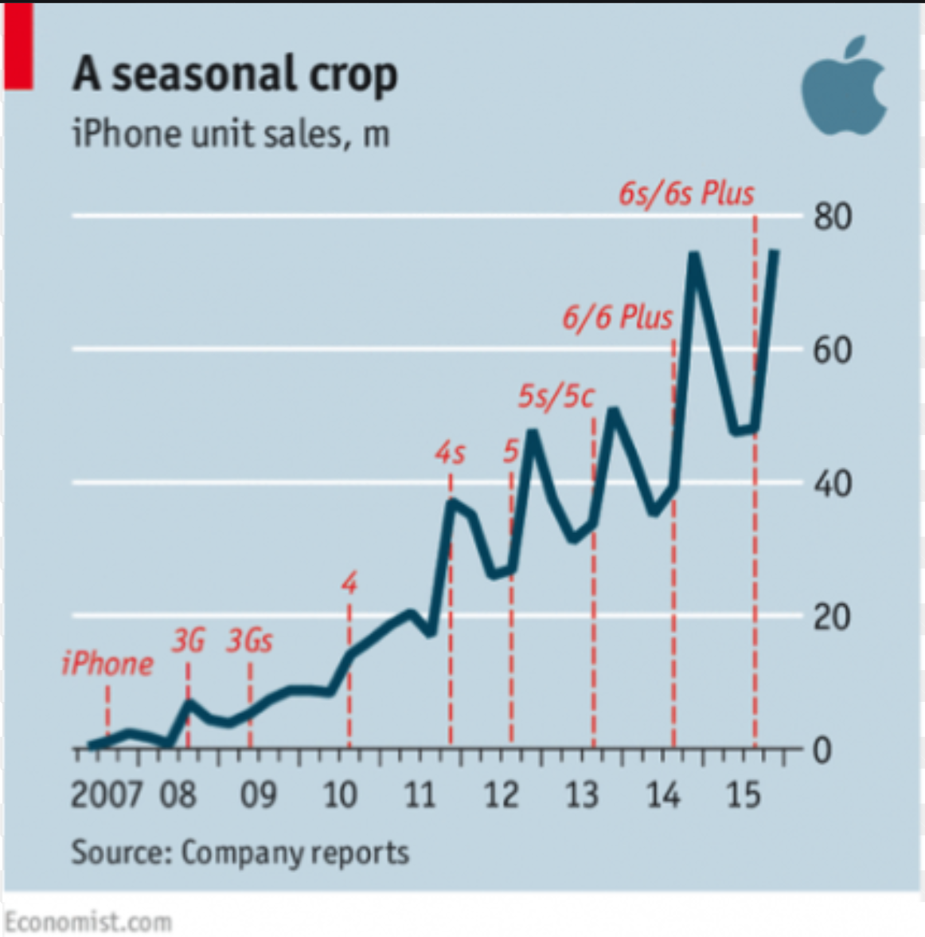
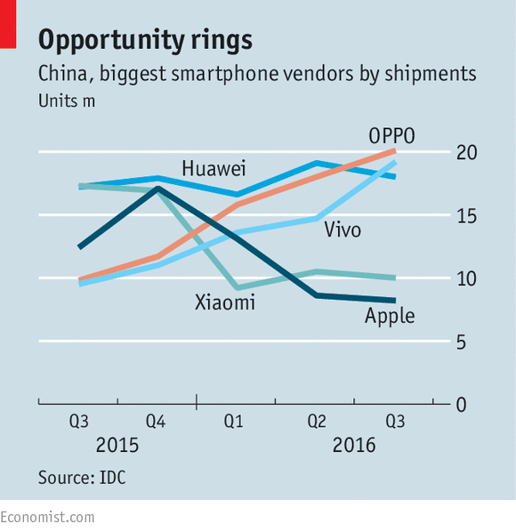
Incremental and Sustaining Innovation
Incremental innovation refers to incremental changes. It happens due to the advancement of the same underlying technology core, addition of new features, and advancement of existing features.
However, innovators have been using cumulative effect of incremental innovation in releasing successive better versions. Such releases have been serving two important purposes. First of all, it has been leveraging advancement of technology, additional knowledge of customer preferences, and unfolding externalities. As a result, perceived value has been increasing, leading to the expansion of market. In some cases, cost has also been falling due to advancement of technology core.
Most importantly, it has been contributing to sustaining the innovation in the market. Innovators are compelled to release better versions at regular intervals for countering the forces of replication, imitation and innovation, and also leveraging externalities like infrastructure and 3rd party component plugins.
For example, within one year, the sale of iPhone came down to zero. Releasing the 3G version was essential requirement for triggering sale up. Since then, Apple has been releasing successive better versions at regular intervals for both sustaining iPhone and penetrating deeper in the market.

Slide 11
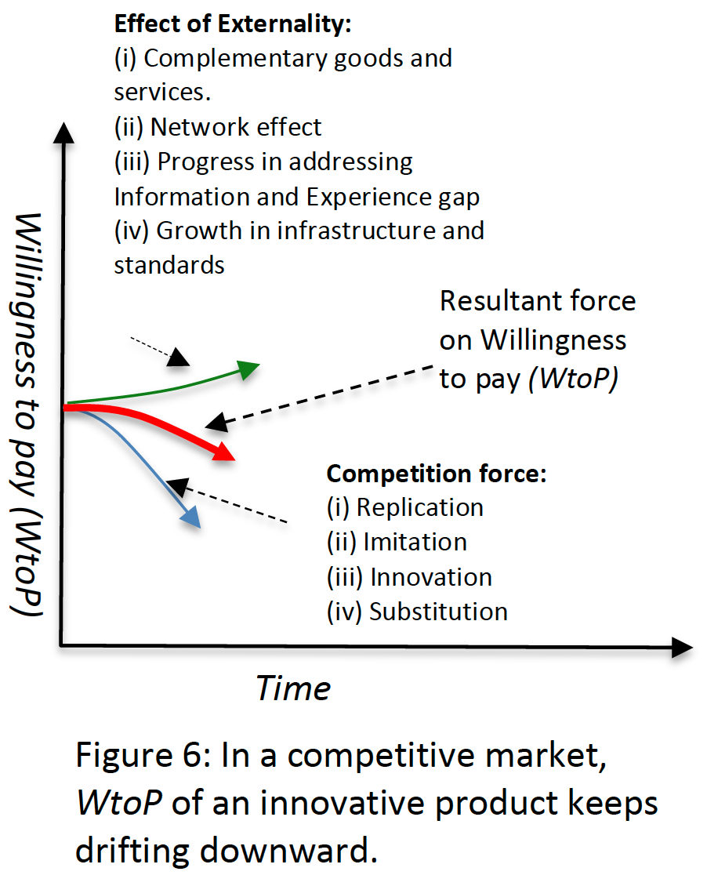
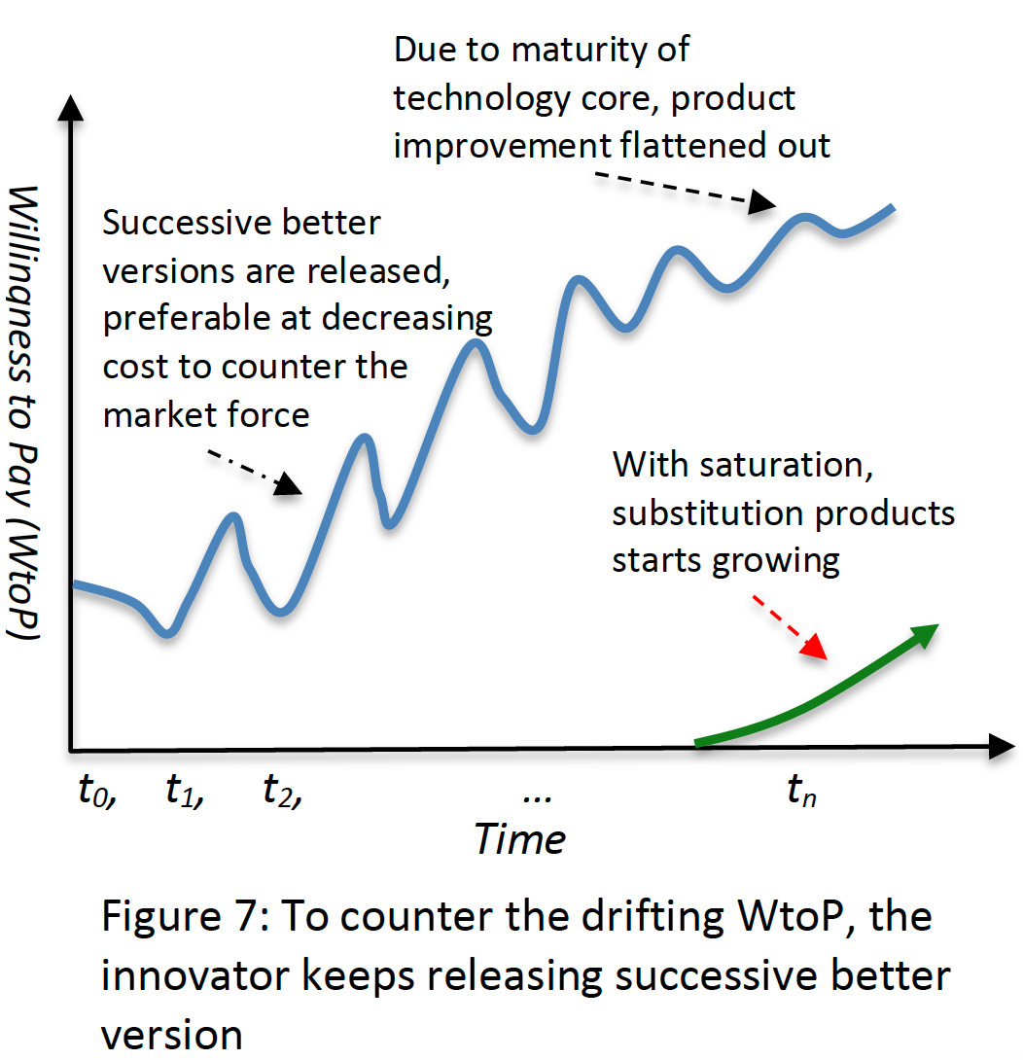
Unpredictable Response from Competition:
Possibility of profitability encourages competition responses, such as (i) replication, (ii) imitation, (iii) innovation, and (iv) substitution. On the other hand, technology possibilities also benefit from (i) complementary goods and services, (ii) network externality effect, (iii) reduction of information and experience gap, and (iv) growth in infrastructure, compatibility and standardization.
To address them one of the common approaches is to fend off competition through intellectual property laws. However, it has limited effect. There has been growing litigation cost and time in pursuing this approach. Another approach is the speed of innovation leading to release of successive better versions, making previous versions less appealing. As a result, followers do not get much time to catchup. This approach also keeps increasing the willingness to pay, leading to market expansion, and revenue growth.
Invariably, the effective means has been to keep releasing successive better versions, preferably at less cost, to sustain the innovation in the market. Hence, innovators need to focus in gathering intelligence and developing idea (patent) portfolio—often, in partnership with technology suppliers.
Furthermore, there has been reinvention threat. Hence, there is also need for gathering early signals, and developing technology inventory and organization capability for dive into self-destruction for recreation at the right moment.

Slide 12
Creative Destruction and Disruptive Innovation
Starting from light bulbs to automobiles, innovations have been growing as waves. Each wave originates from the reinvention out of new technology core.
Each wave begins the journey in embryonic form. However, due to the progression of the underlying technology core, reinvented new wave keeps growing. If that new wave succeeds to grow as a better, and also cheaper, alternative to the existing one, incumbent mature products suffer from the erosion of demand--leading to experiencing destruction effect. Prof. Schumpeter termed it as creative destruction. However, sustaining innovation may also create such destruction effects to previous releases, around the same technology core.
If this new wave is driven by new entrants and incumbents fail to switch, incumbent producers of products around mature technology core suffers from the loss of business and jobs. Prof. Clayton termed it disruptive effect, and renamed creative destruction as disruptive innovation.
Incumbent may fail to switch for multiple reasons. First of all, management face decision dilemma in moving resources from profit making activities of producing mature products to the entry of loss making operation of producing emerging products. The next one is the incompatibility of business models, manufacturing facilities, competence need, and supply chains. Another one is the patent barrier. Often, new entrants develop patent portfolio around the new technology core to create barrier to the late switching attempts.

Slide 13
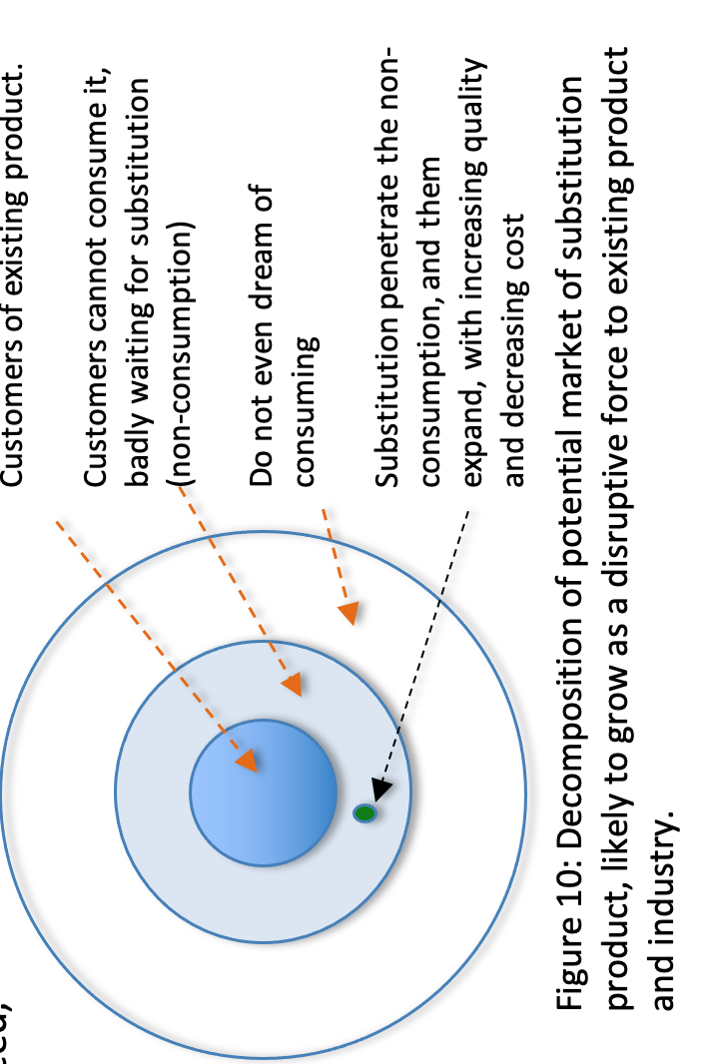
Characteristics of Creative Destruction—for civilian innovations
There have been six major characteristics:
(i) The potential market should be decomposable into 3 concentric circles, with a strong presence of non-consumption, as shown in Fig. 10.
(ii) The substitution product should be around an emerging new technology core, which is at the growth stage in its life cycle.
(iii) Irrespective of the greatness of the idea and strength of the technology core, initial emergence of substitution would be in primitive form causing a very faint substitution effect on the targeted existing product.
(iv) Primitive versions should create a willingness to pay among non-consuming customers to start generating revenue and offering feedbacks supporting subsequent development; such primitive product will create very little wiliness to pay among a small group of customers generating loss-making revenue.
(v) The underlying technology core should be amenable to rapid growth (as well as expansion by integrating with complementary technologies) through R&D leading to sharp improvement of quality (Q) and reduction of cost (C)—consequentially increasing sale and turning loss-making revenue into profit.
(vi) Quality improvement and cost reduction will capture the non-consumption segments and will also penetrate the core market of the existing product, causing disruption, and will also expand to the periphery creating a larger market than before.

Slide 14
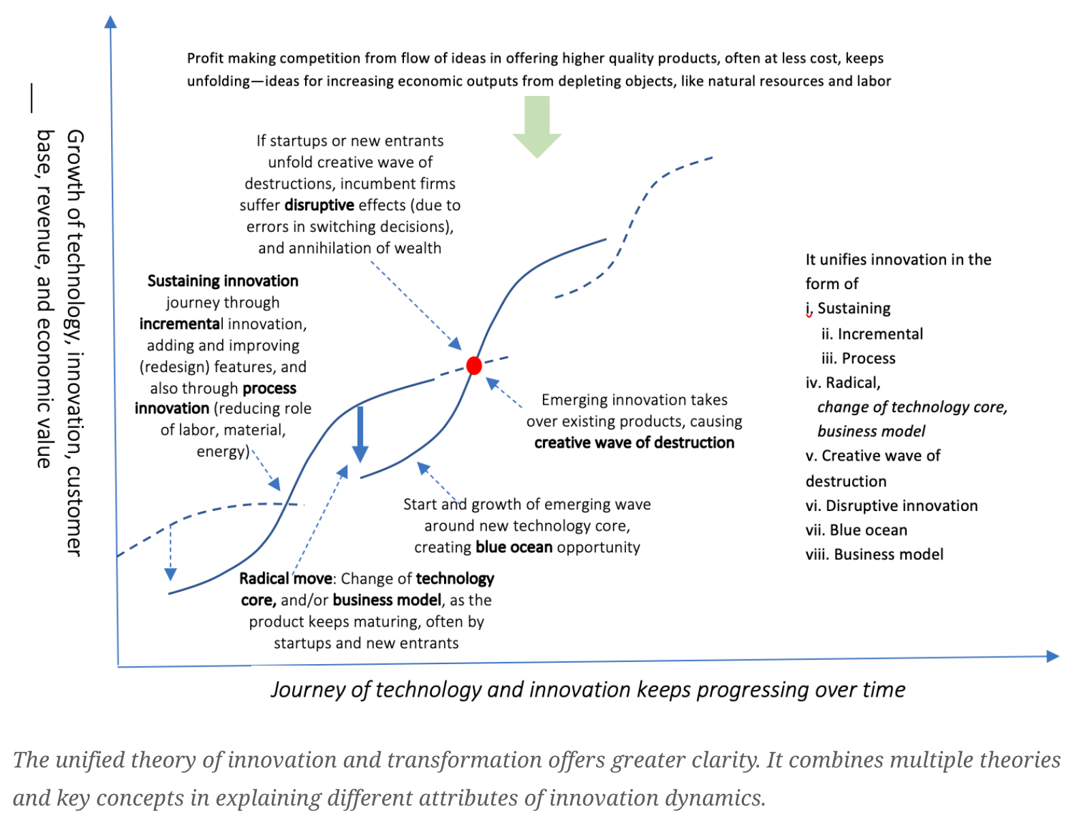
Unified Theory of Innovation
The unified theory presented here combines eight distinctive perspectives of innovation. The first three are incremental, process, and sustaining innovation. The radical step by changing the technology core and/or business model leads to the formation and growth of new waves of innovation. Often, they grow as a creative wave of destruction.
Apart from causing destruction to existing products, some of them also cause disruption to existing firms.
Particularly, if startups or new entrants pursue the radical move in growing creative wave of destruction, incumbent firms often fail to switch to the next waves. Consequentially, it leads to suffering from disruption. This transformation is at the core of the market economy for offering us continued prosperity.
https://www.the-waves.org/2020/08/10/unified-theory-of-innovation-and-transformation

Slide 15
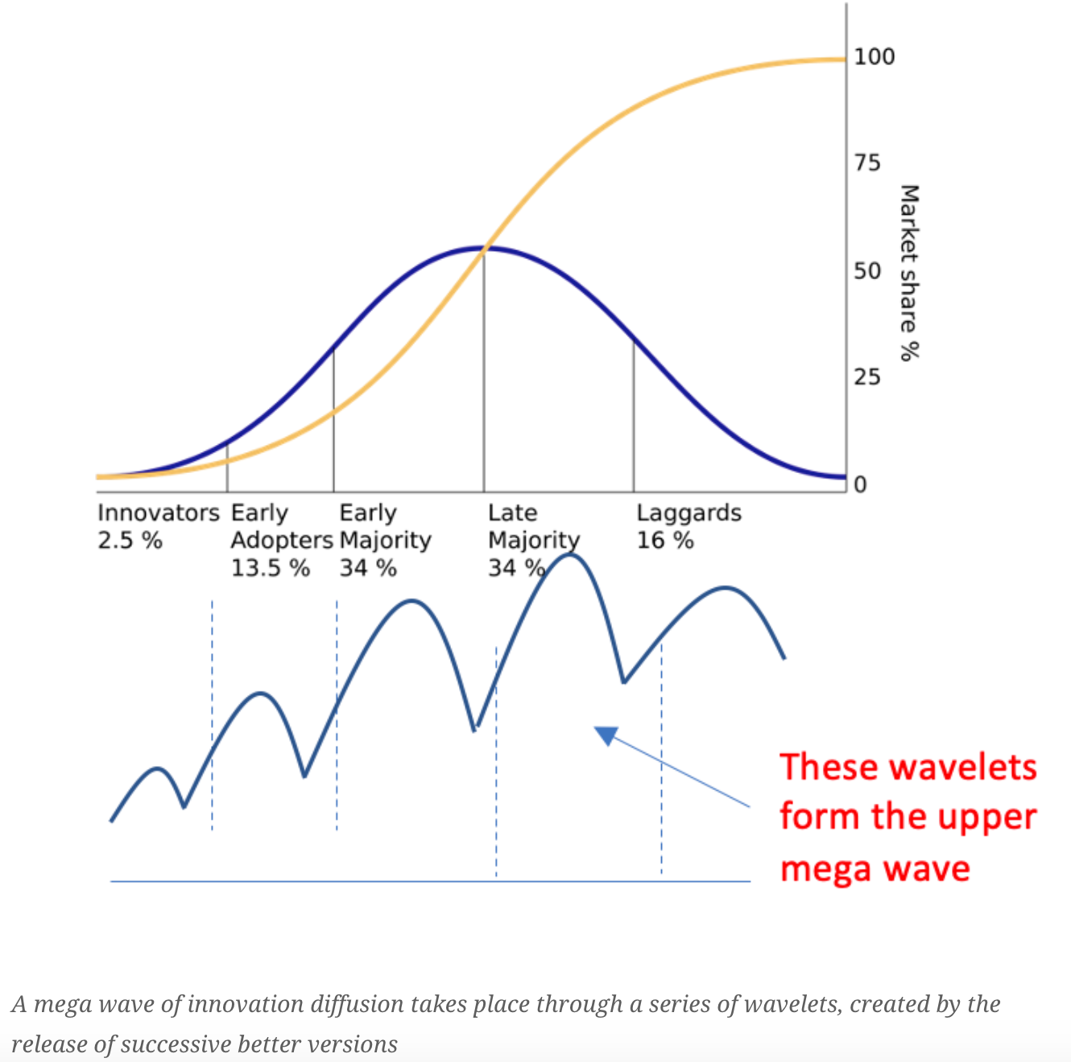
Innovation Diffusion Patterns—wave theory
Wave theory of innovation diffusion attempts to capture the wavelets of diffusion, caused by the release of successive better versions, subsequently, forming a mega wave. Incremental innovation, leveraging the advancement of the underlying technology core and complementary ones, adds and enhances features for releasing successive better versions.
However, this journey of releasing better versions for diffusing the innovation further slows down due to the maturity of the technology core. The subsequent change of technology core leads to the formation of the next mega wave, diffusing the innovation further deeper.
This wave theory of innovation plays an important role in explaining the innovation diffusion being shaped by technology advancement and also the competition. The introduction of wavelets takes into consideration of the release of subsequent better versions. Most importantly, it covers the formation and growth of successive waves due to the change of technology cores. Hopefully, it will bring greater clarity in the magical journey of diffusion of innovation for systematically ferreting out value.
https://www.the-waves.org/2020/10/05/wave-theory-of-innovation-diffusion/

Slide 16
10 Principles of Innovation
The competition of profiting from ideas, invariably, makes the process unpredictable and also messy. Often, entrepreneurs suffer from loss, and they also get caught into inescapable loss traps. The creative force of successive waves of innovation also cause instability in the market. On the other hand, offering prosperity also creates transformational pain for the society as a whole. In retrospect, the market economy’s innovation swath is littered with deaths of start-ups, job loss, carcasses of once-dominant firms, deserted towns, and exhausted nations. In this swath of destruction, we also witness the uprising of new firms, even countries.
On the other hand, innovation is the only window for increasing wealth from depleting resources to meet the growing consumption of fellow human beings. However, we need a less messy journey to leverage ideas for driving prosperity. Here are some characteristics or principles we should pay attention to managing innovation in the market economy.

Slide 17
Principle 1: Innovation opens endless frontier of wealth creation
We mix ingredients with ideas to produce economic output. The value of outputs depends not only on the quality of inputs but also on the idea of mixing them. To offer a proper place to the idea, Prof. Paul Romer has articulated economic output as a function of ideas and objects.
Objects include natural resources, labor, energy, land, factory building, and many more. All these objects are mixed with ideas. Due to natural limitations, our ability to increase the supply of objects is limited. On the other hand, we have a growing need of consumption. Besides, we should also lower the adverse effect of economic output production on soil, water, and air. The idea is our tool to address this conflicting situation.
Unlike objects, ideas do not face supply limitations. In fact, better ideas lead to redesigning existing products and innovating new ones to get our job done better while consuming fewer resources and causing less harm to the environment. Therefore, innovation offers the opportunity of opening an endless frontier of wealth creation, driving our continued prosperity. Hence, timely public support should be provided in synchronization of unfolding opportunities and private initiatives.

Slide 18
Principle 2: Innovation has a natural tendency of starting the journey with loss-making revenue
Irrespective of the greatness and strength of the underlying technology core, ideas often emerge in primitive form. Ideas at the nascent stage need further improvement to succeed in creating a willingness to pay among the target customers. Often they require intensive R&D over several years to make the idea strong enough to release products. Even after succeeding in generating sales, often, the revenue in the early days produces a loss. For example, the idea of an electric vehicle is a great one. Despite the greatness, still to date, it produces loss-making revenue. Turning this loss-making revenue into a profitable one is a daunting challenge. Moreover, all ideas do not have the potential to reach profit.
Due to inherent limitations, and also because of competition situations, often, entrepreneurs get caught in loss-making traps. Sometimes, they are inescapable. This is one of the root causes of the high mortality rate of start-ups. As high as 90 percent start-ups, even in Silicon Valley, fail due to it. Hence there is a need of management practices for assessing the progress of ideas. How far development needs to be made to reach profitability is often uncertain. Most importantly, to figure out whether the journey of taking ideas to market is caught in inescapable loss trap is daunting.

Slide 19
Principle 3: More than Eureka moment– an incremental progression of both product and process is the key
As explained before, invariably, ideas enter the market in generating loss-making revenue. Of course, there is a need for a subsidy to remain afloat. But subsidy alone does not turn loss-making revenue into profit. The core challenge has been to keep increasing the quality and reducing the cost of the innovated products. Hence, there is a need to keep producing ideas. These ideas should be used to add new features, improve existing features, and enhance the production process. The key challenge is to keep increasing the willingness to pay and reducing costs for increasing revenue and reducing loss. As a result, the Eureka moment ends up into a relentless journey of continued product and process enhancements.
This journey may last over 10, 20, 50, and even 100 years. For example, since Carl Benz’s patent was issued in 1887, Automobile has been going through a series of incremental innovations. Moreover, along the way, there might be a need to change the technology core to keep driving the progression. For example, innovators changed the technology core of light bulb three times over the last 100 years. They changed it from carbon or bamboo filament to tungsten wire, which was replaced by fluorescence leading to the next change with LED. However, technology core change creates discontinuity. Sometimes, this discontinuity opens the door for new entrants, often causing a disruptive effect.

Slide 20
Principle 4: Competitive market force demands successive better versions
In the market economy, the willingness to pay for an innovative product is not static. It does not depend only on the benefits or utility the product offers. Most importantly, it depends on a set of variables, which keep changing. Hence, willingness to pay of innovation is a function of time. The underlying variables fall into two main categories. The first category is the competition. It comprises of competitors’ responses in the form of i. replication, ii. imitation, iii. innovation and iv. substitution.
Once the product enters the market, the competition force keeps drifting the willingness to pay (WtoP) downward. On the other hand, the WtoP also keeps benefiting from the externality effects. The effects of i. complementary goods and services, ii. network externality effect, iii. reduction of information and experience gap, and iv. advancement of infrastructure and standards keep driving WtoP up.
However, the resultant force of externality and competition keeps pushing the willingness to pay for the innovative product downward. Even the magical iPhone could not escape from this reality. To counter it, innovators are compelled to keep releasing successive better versions, consequentially pushing up the WtoP. The challenge is to keep raising the WtoP in the midst of the effect of these eight and other variables. Such reality demands a serious focus on managing innovation in the market economy.

Slide 21
Principle 5: Newly formed wealth creation territory is invaded and expanded by followers
Irrespective of the greatness of the idea and patent barrier, followers will enter to take a piece of the profit-making opportunity. Possible entry opportunities are through i. replication, ii. imitation, iii. innovation and iv. substitution. Some of the followers will replicate, offering the clone. Often some governments condone intellectual property rights issues to encourage such cloning of foreign products by their local firms.
A few of them will also imitate similar products by imitating either certain features or the whole product. Often imitators also grow as innovators. For example, iPhone triggered an imitation response from Samsung. Upon predicting the bright prospect of iPhone, Samsung started imitating multitouch features in her mobile handsets line. Subsequently, Samsung has succeeded in innovating certain features on their own.
However, followers like Oppo or Vivo imitated the whole iPhone, as opposed to selective components. On the other hand, Apple entered the smartphone business by following component level substitution strategy. It replaced once-dominant keyboard designs and stylus with the multitouch based user interface. This component-level substitution effect plummeted the WtoP of keyboard-based smartphone designs of Nokia. Due to slow response, Nokia suffered a catastrophic consequence.

Slide 22
Principle 6: Successive waves of disruptive innovations keep emerging
As opposed to experiencing substitution effect at the component level, often substitution shows up at the whole product level. Alternatives show up around a new technology core. At the beginning, they emerge in very primitive form, creating very little or no willingness to pay to users of incumbent products. This primitive emergence often communicates misleading signals, particularly to incumbent firms. Primitive appearance, creating loss-making revenue, places managers of incumbent firms in a decision dilemma.
In fact, the potential remains hidden in the technology core. Innovators pursuing substitution accelerate R&D investment in advancing the technology core, leading to subsequent better versions and decreasing cost.
Over time, once primitive substitution grows as a creative wave of destruction to incumbent products. This is known as Schumpeter’s creative destruction. Furthermore, the decision Dilemma of switching to emerging technology core often leads to disruption of firms.
Prof. Clayton Christensen termed this effect of an emerging wave as disruptive innovation. There are plenty of examples around us. Starting from a digital camera, PC to iPhone, the list is endless.

Slide 23
Principle 7: Innovation is not benign
Innovation is at the core of market economy for offering us increasing prosperity and higher quality of living standards. But it delivers such promises through a messy process. It begins with the suffering of millions of creative youths pursuing start-ups.
The potential of profiting from ideas takes them in the journey of start-ups. They invest their time and money from the pockets of their family, friends, and outside investors. Unfortunately, more than 90 percent of these start-ups do not reach profitable revenue. Subsequently, they fold up suffering loss from multiple dimensions.
It’s being learned that this stressing process creates significant mental pressure, sometimes leading to ill mental health, problems in personal lives, and financial chaos. In some instances, it leads to suicide and jail terms.
On the other hand, the unfolding of a creative wave of destruction leads to loss of jobs, firms, industries, and wealth annihilation. Such a painful experience is demanding better insights for managing innovation in market economy.

Slide 24
Principle 8: Fuels monopolistic market power accumulation, and also expands trade
Although innovation is the core strength of the market economy, but it also weakens the invisible hand to govern competition. By leveraging innovation, monopolistic firms emerge with price-setting capability. To counter it, frequently, Governments get busy with the application of antitrust laws.
On the one hand, price setting market power weakens the competition force to pursue innovation. On the other hand, the application of antitrust laws runs the risk of throttling innovation.
The alternative could be to increase public funding for university-based R&D to increase the supply of ideas to fuel the next wave of start-ups and innovation. However, innovation increases trade.
Therefore, managing innovation in the market economy should take into consideration of the effects of innovation on monopolization, weakening competition, and expansion of trade.

Slide 25
Principle 9: Necessitates the dealing with conflicting outcomes
Innovation in the market economy often runs the risk of directional failure. For example, innovative features for creating an addictive association with smartphone increases screen time. Due to an advertisement based revenue model, it’s an attractive option for the innovators, but at the cost of the overall benefit of society. Hence, managing innovation in the market economy is often challenging.
In a broad sense, we are facing the challenge of meeting these 10 objectives simultaneously: 1. better products at lower cost serving more consumers, 2. more jobs are created than lost, 3. less harm done to the environment and natural resource stock, 4. higher pay for all segments of the employment pyramid, 5. growing profit, 6. greater opportunity for Inclusive and equitable participation in wealth creation, 7. more tax revenue for the government, 8. increasing security and collective well being, 9. intensify competition, and 10. ??. Often these variables are conflicting in nature. For example, innovation has a natural tendency to cause labor-saving effects, resulting in job loss. How to pursue innovation to address all these variables poses significant management, policy, and regulatory challenges.

Slide 26
Principle 10: Demands policy reform, realignment of cultural values and rational decisions
Ideas are feed to the growth of innovation. Of course, we need creative minds to generate ideas. The process of idea generation also demands the advancement of knowledge. Moreover, a single great idea needs the support of flow ideas, often lasting for decades, to succeed. To ensure this flow, we need institutional capacity, which often demands S&T policy reform. On the other hand, local demand should be created for emerging ideas.
Policy support is required to create the initial demand for innovative products, particularly at the early stage. For example, the US government’s defense technology policy is vital for creating the demand for early-stage innovations. Similarly, economic and industry policies play a vital role in stimulating demand.
In addition to it, culture also plays an important role. Invariably, ideas demand craftsmanship spirit for pursuing the relentless journey of refinement, often lasting for decades. Moreover, this craftsmanship spirit should be linked with scientific discoveries and technological inventions.
For example, the Japanese have shown a high success rate by blending craftsmanship spirt with the institutional approach of scientific discoveries and invention. Due to this unique capability, Sony grew from the ash of world war to disrupt American and European technology icons, while one of R&D team members won the Nobel prize. Similar successes are in lithium-ion batteries and also in the LED light bulb.

Slide 27
Misleading Innovation Index
As innovation is the primary driver of economic growth, there have been several performance indices measuring the overall innovation capacity of a country. Among these indices, the Global Innovation Index prepared by World Intellectual Property Organization (WIPO) in partnership with INSEAD and Cornell University appears to be a notable one.
This index measures the competence of 127 countries by taking into account 80 parameters under seven broad categories. Bloomberg is publishing the second important one based on reflection of capabilities in seven major groups. Innovation competence forms the 12th pillar in The Global Competitiveness report released by the World Economic Forum. Instead of focusing on the economic benefits obtained through innovation, the parameters used by these indices mostly concentrate on underlying capabilities.
But often the same underlying capacity makes a varying contribution to economic growth in different countries. As a result, such indices often provide misleading barometer about the capability gap. Despite such discrepancies, decision-makers, particularly in developing countries, perceive these indices as leading references on innovation, and 'tools for action'. Moreover, international organizations like UNESCO have been measuring the progress of innovation competence in developing countries based on the indicators used in these indices, and are advising them accordingly.
Among others, quality of scientific research institutions, publications, patents, R&D investments, industry-university collaborations, availability of science and technology graduates, and government procurement of advanced technology products are major areas of focus to assess the innovation ability in the Global Competitiveness report. These are supply-side components for driving innovation. But to drive economic growth, such supply-side inputs should be converted into new products and processes or used for improving existing ones. To do so, there should be demand in the local economy, and risks should be taken into consideration to nurture ideas around those inputs.
In the absence of the ability to turn intellectual assets produced by the supply capacities to offer better products at lower cost, often investments made to strengthen those capacities lead to wastage of resources. Notably, in developing countries, the situation is quite unfavourable. To deal with the competitiveness of an economy, often governments prefer to provide incentives in the form of lowering taxes on imported technologies weakening the local innovation demand. Due to weak demand for local innovation, often S&T graduates find themselves unemployed or underemployed. As a result, a growing number of S&T graduates fail to contribute to economic growth through innovation.
https://thefinancialexpress.com.bd/views/misleading-nature-of-innovation-indices-1533656154

